Slide 1
Blue green deployment using ALB

Slide 2
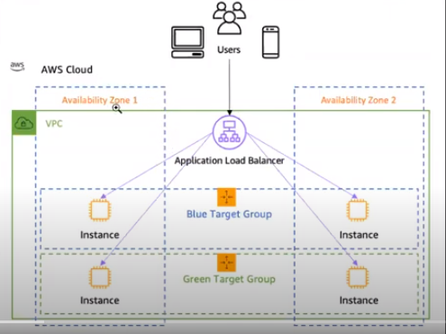

Slide 3
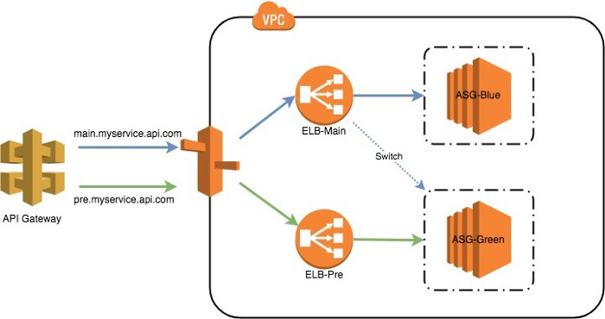
Blue/Green deployment with Classic Load Balancer

Slide 4
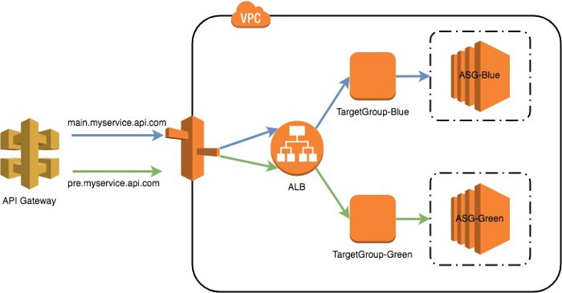
Blue/Green deployment using ALB

Slide 5
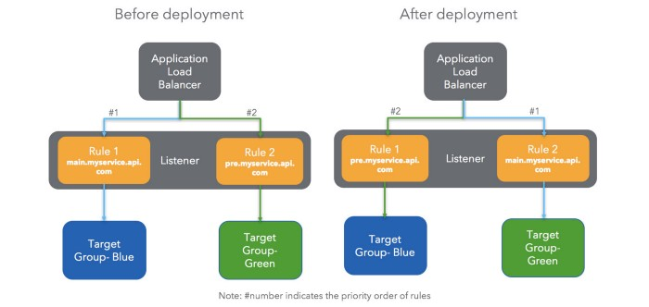
Cut-over

Slide 6
Pricing
Classic Load Balancer=$0.025*24hours*2instances=$1.2 per day.
Application Load Balancer=$0.0252*24hours*1instance=$0.54 per day.
the cost of Application Load Balancer is 10% lower than that of a Classic Load Balancer.

